Slide 1
Assignment 8 Hi-Fi Prototype
Team Gloo

Slide 2
Presentation Outline
01
Introduction
02
Heuristic Evaluation
03
Major Revisions
04
Prototype Status
05
Prototype Demo
06
Appendix

Slide 3
Introduction
01
Meet the Team, Value Proposition, Problem + Solution Overview

Slide 4
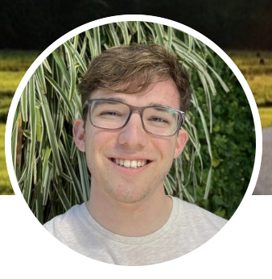
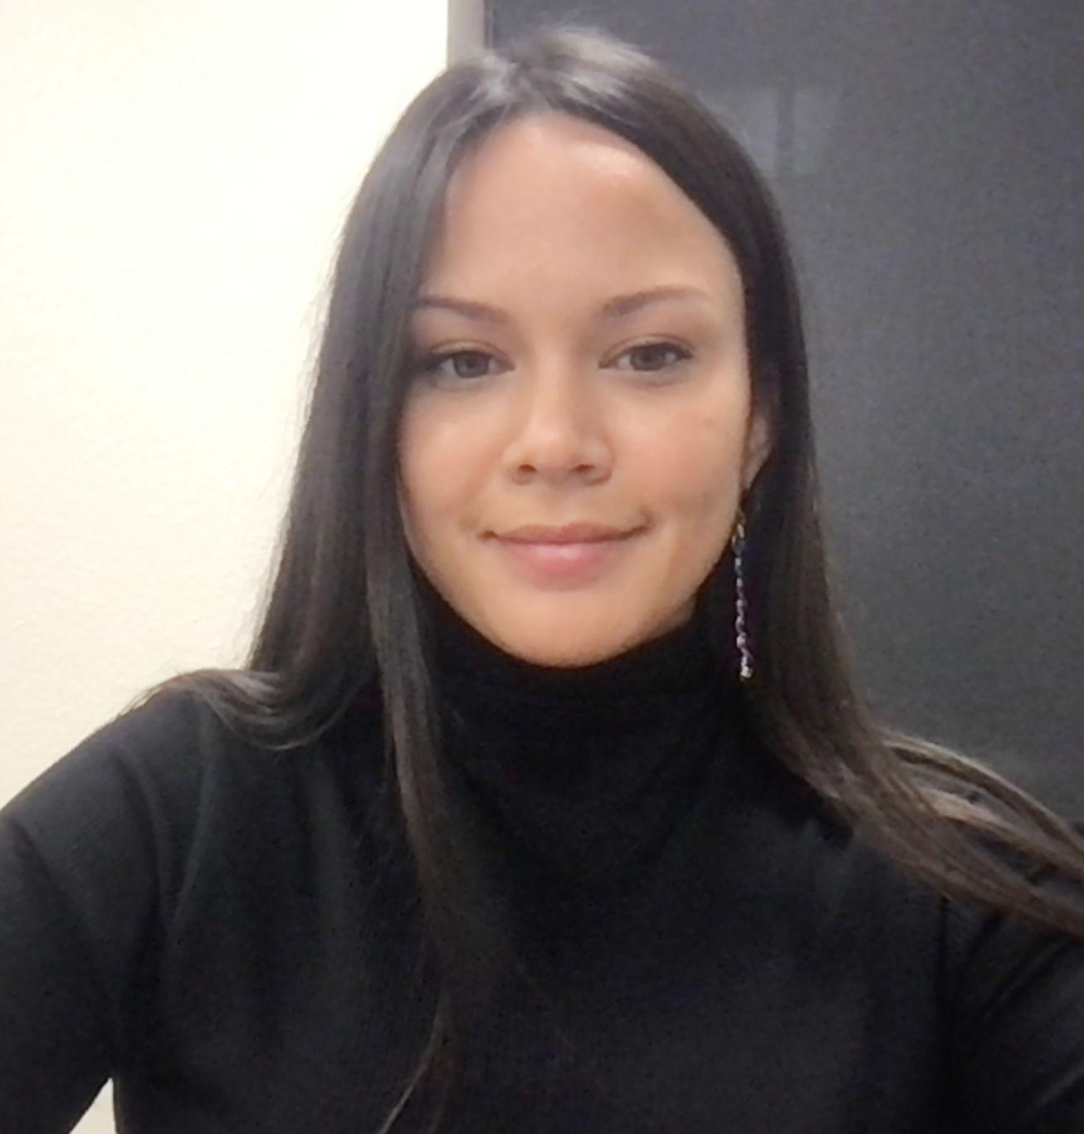
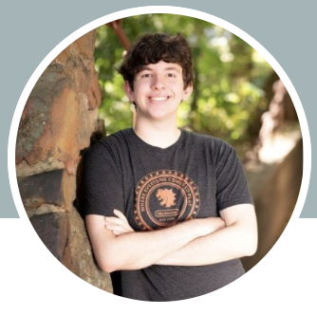
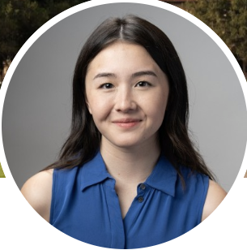
Our Team
Justin Blumencranz
Monica
Hicks
Matthew
Mattei
Alison
Rogers

Slide 5

Gloo
Making student-teacher connections that stick!

Slide 6
Problem
Especially in larger schools, students feel daunted by, and disconnected from, the college application process while teachers have a hard time connecting with students and being able to advocate for them.

Slide 7
Solution
A platform for high school students and teachers who feel disconnected due to the large size of their school to easily schedule times to meet and connect with each other.
Gloo includes a journaling interface to help both students and teachers remember and reflect on their interactions for future reference and an AI algorithm based on interests and student journals to help create personalized teacher
recommendations for students.

Slide 8
Heuristic Evaluation
02
Violation Breakdown + Change Justification

Slide 9
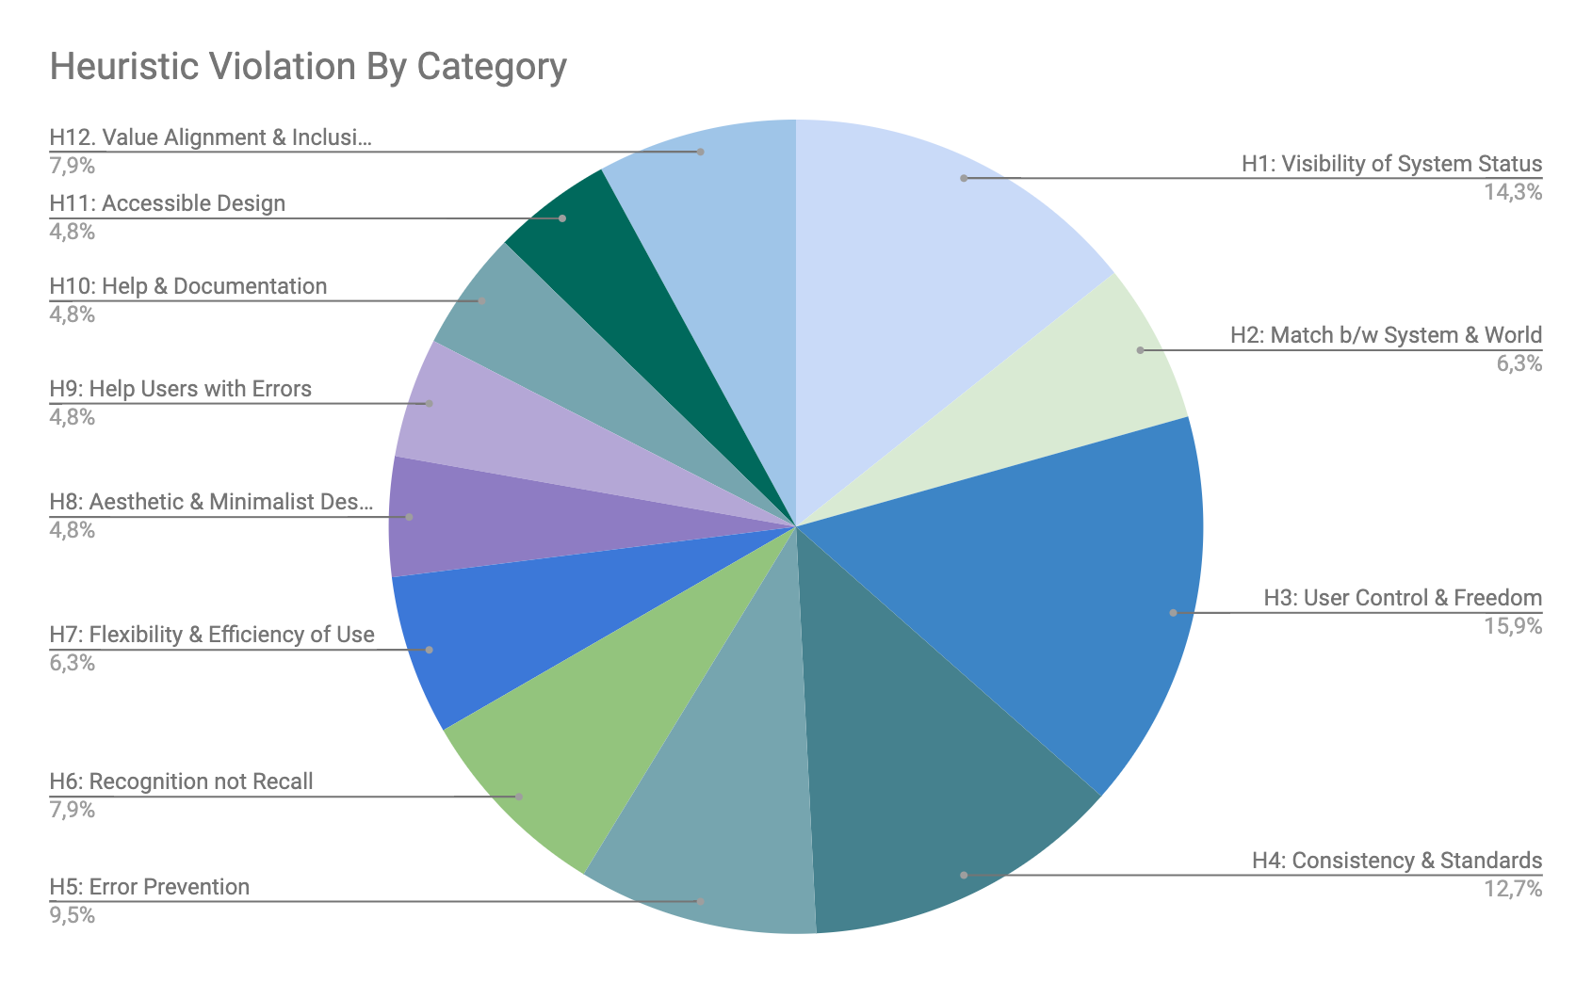
High-Level Heuristic Summary
Total Violations: 65
Most Common Violations
User Control + Freedom
Visibility of System
Consistency + Standards

Slide 10
Heuristic Breakdown by Category + Severity
 | H1 | H2 | H3 | H4 | H5 | H6 | H7 | H12 | Total
Sev 0 | 0 | 1 | 2 | 3 | 2 | 1 | 1 | 2 | 12
Sev 1 | 2 | 1 | 2 | 3 | 1 | 2 | 1 | 3 | 17
Sev 2 | 5 | 1 | 4 | 1 | 2 | 1 | 1 | 0 | 22
Sev 3 | 2 | 1 | 2 | 1 | 2 | 0 | 1 | 0 | 11
Sev 4 | 0 | 0 | 0 | 0 | 1 | 1 | 0 | 0 | 3
* Full table in appendix
Notes:
All 4 sev 4 tasks, 5 sev 3, 8 sev 2, 4 sev 1

Slide 11
Planned Revisions
Provide error warnings when abandoning tasks
Sev: 4 (rows: 12)
Avoid abbreviations (“D” for day, “OH” for Office Hours”)
Sev: 4, 3 (row: 13, 22)
Provide higher contrast between tentative and registered OH
Sev: 4 (row: 14)
Add “Filter” or “Sort” to drop down menu
Sev: 3 (row: 19)
*row elements sorted by severity
Notes:
Alerts exist

Slide 12
Planned Revisions
Display current student name when drafting journal entry
Sev: 3 (row: 20)
Include formatting and AM/PM for calendar times
Sev: 3, 2 (row: 21, 33)
Swipe to delete journal entries
Sev: 3 (row: 23)
Provide onboarding popups
Sev: 3 (row: 18)
Provide alternate content viewing for calendar
Sev: 3 (row: 25)
*row elements sorted by severity
Notes:
Alerts exist

Slide 13
Unincorporated Revisions
Tooltip for password
Sev: 3 (row: 15)
Posting every available OH greyed out on the calendar
Sev: 3 (rows: 16)
Hiding your own OH + undo-delete Office Hours
Sev: 3 (row: 17)
Change “Recent” to “Recent Journal Entries”
Sev: 3 (row: 24)
Already exists
Overcrowding
Bad visibility
Not standard
Labeled above
*row elements sorted by severity

Slide 14
Revision Summary
Incorporated: 20
Unincorporated: 8
If Time: 25
Severity 4
Severity 3
Incorporated: 3
Unincorporated: 0
If Time: 0
Incorporated: 6
Unincorporated: 4
If Time: 1
Severity 2
Severity 1
Incorporated: 7
Unincorporated: 3
If Time: 12
Incorporated: 4
Unincorporated: 1
If Time: 12

Slide 15
Major Revisions
03
Before + After, Rationale, Progress Towards Usability Goals

Slide 16
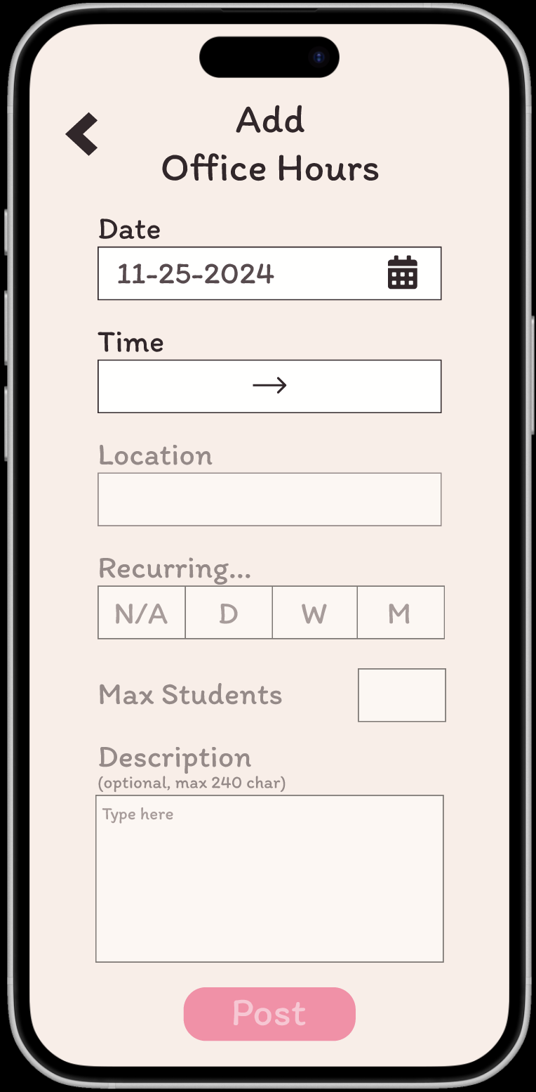
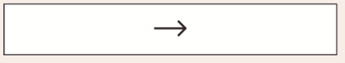
Office Hours Entry Page Revisions
Added HH:MM
and AM/PM
HH : MM HH : MM
AM
AM
Daily
Weekly
Monthly
None
Remove abbreviations

Slide 17
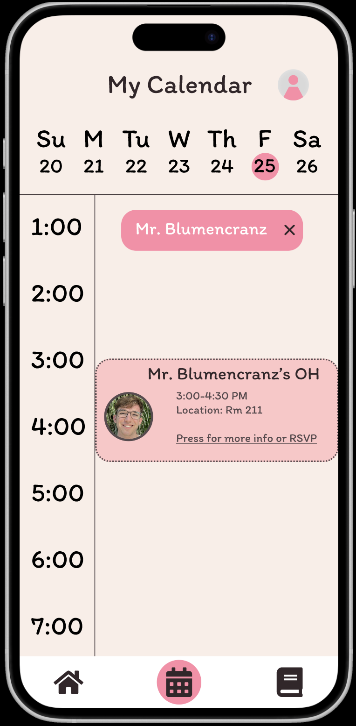

Calendar Page Revisions
Grey background
OH → Office Hours
Mr. Blumencranz’s
Office Hours
3:00-4:30 PM
Location: Room 211
Press for more info or RSVP
Toggle calendar view
Week View
Month View

Slide 18
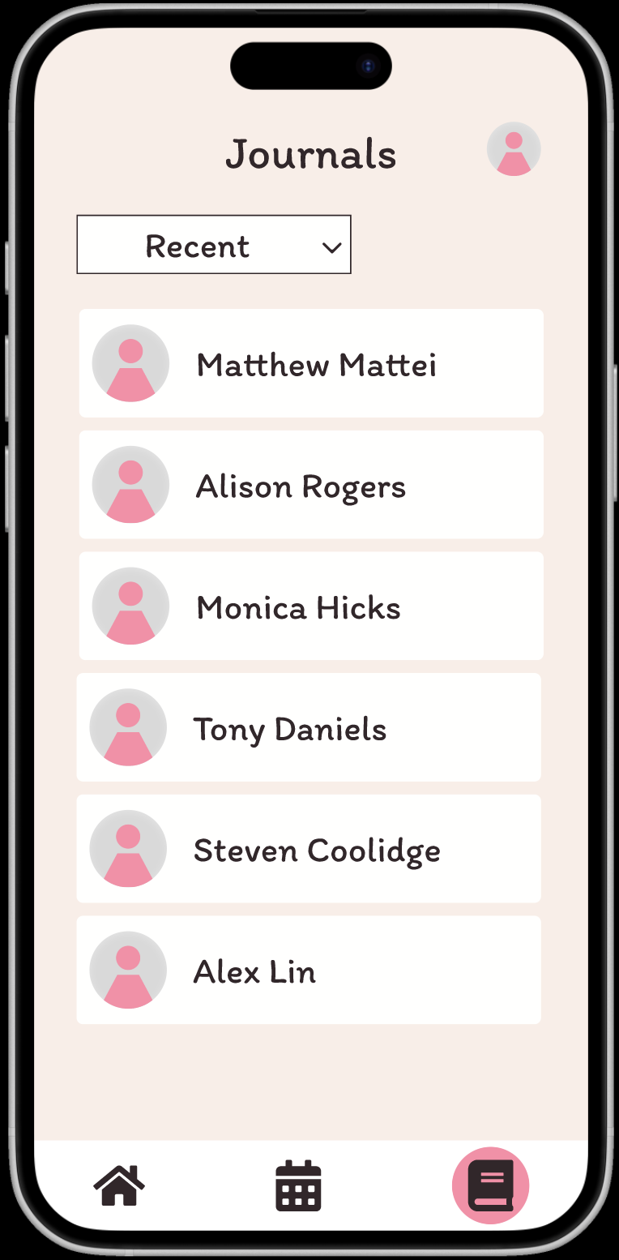
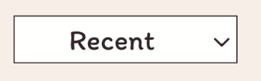
Journal Home Page Pop-up Addition
Sort by:
Welcome to Journals!
Journal entries help you keep track of student interactions!
Click on a student’s name to view all entries you’ve made for that student.
Onboarding pop-up window
...

Slide 19
Journal Home Page Revisions
Added “Sort by:”
Sort by:

Slide 20
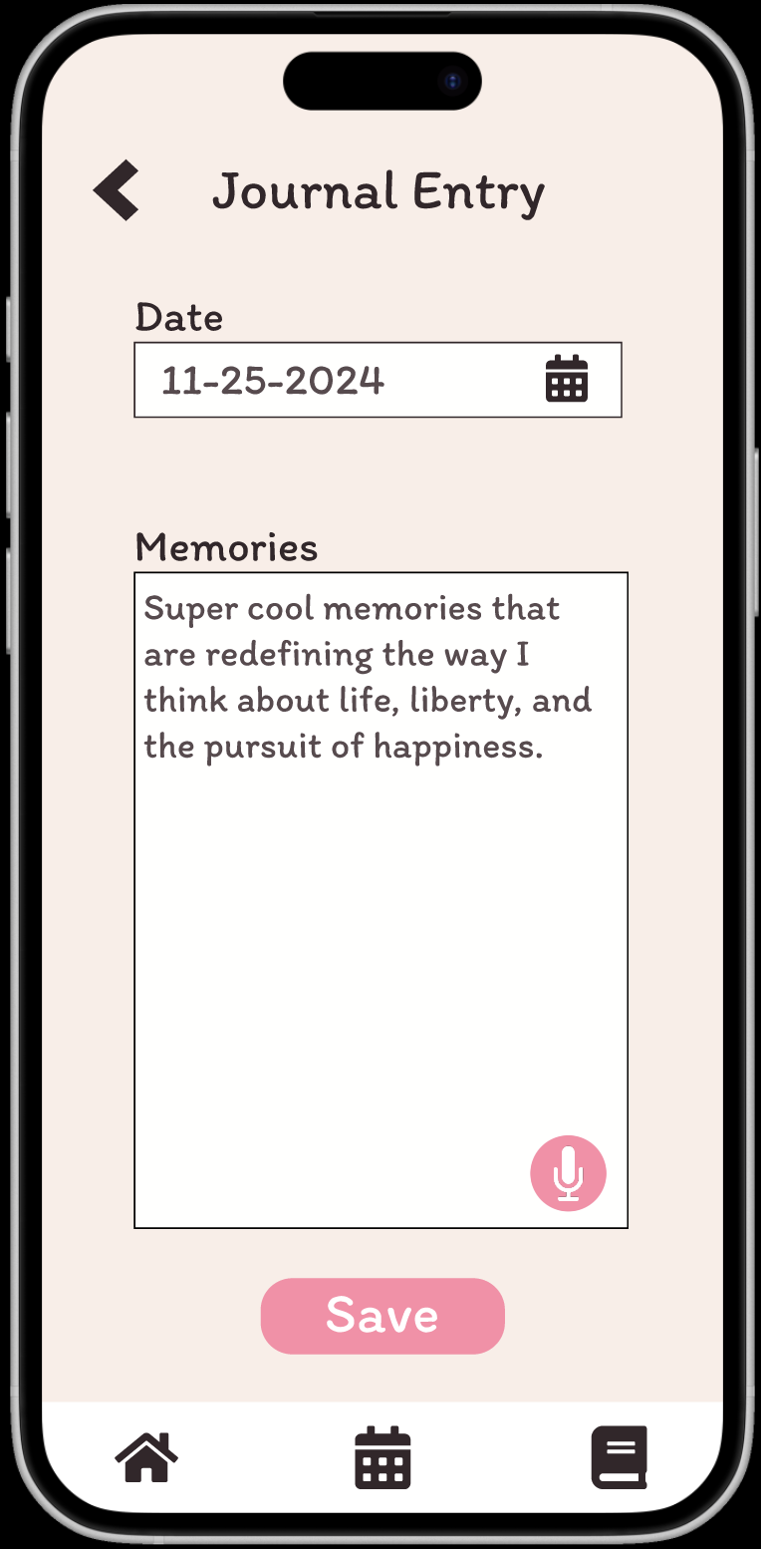
Journal Entry Page Revisions
Add student name to journal entry form
Matthew Mattei
Are you sure you want to abandon this journal entry?
Add notification for journal entry abandonment
Discard
Save

Slide 21
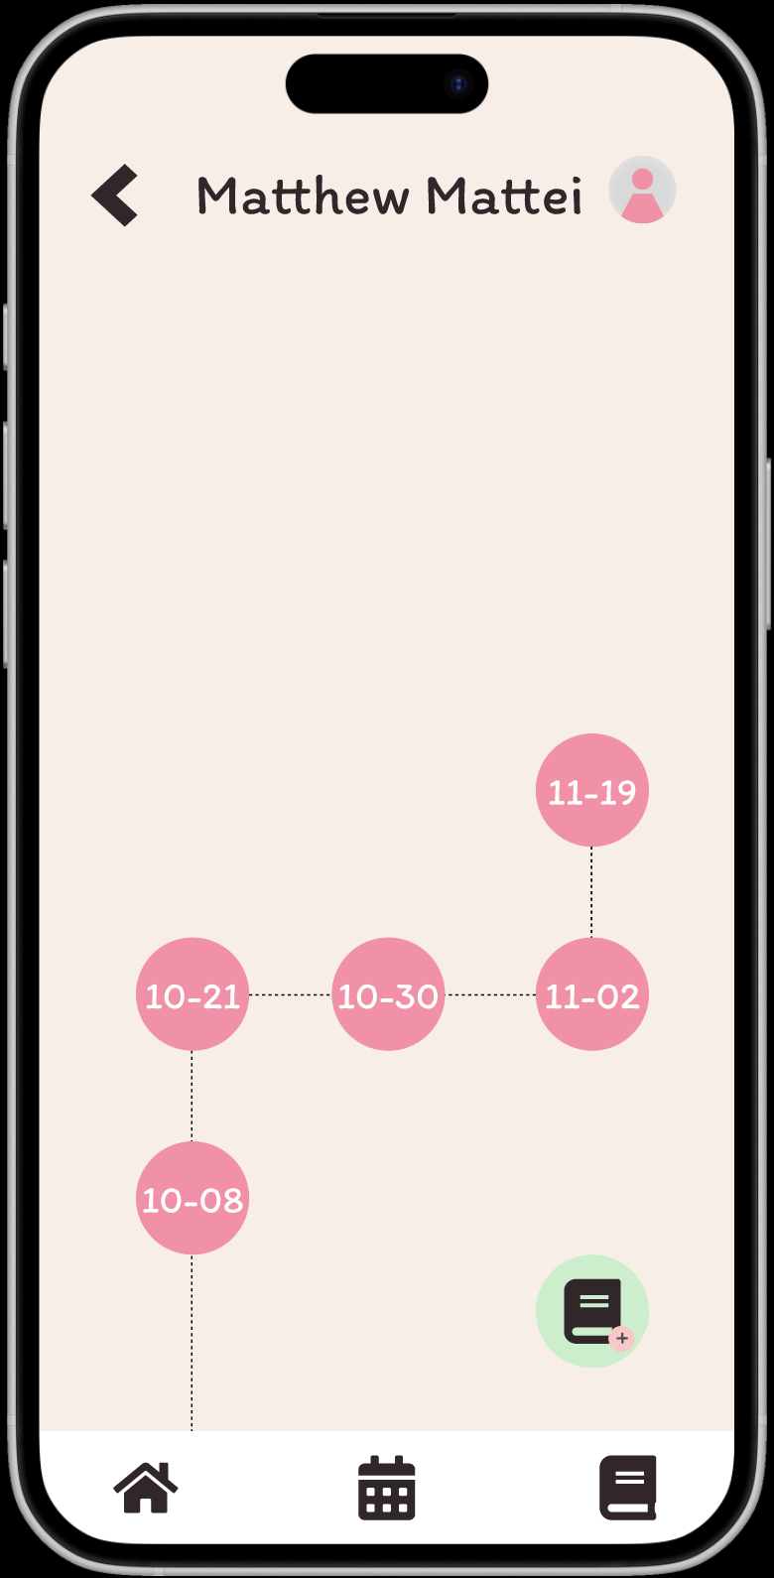

Student Journey Page Revisions
HH : MM HH : MM
AM
AM
Swipe to delete journal entry
Swipe left to delete an entry
Daily
Weekly
Monthly
None

Slide 22
Progress Towards Usability Goals
We made progress towards our goal of having a navigable app by adding onboarding pop-up windows and incorporating large, clickable navigation tools such as switching between calendar views or swiping to delete journal entries.

Slide 23
Progress Towards Usability Goals
To improve accessibility, we incorporated higher-contrast elements on the calendar, and we added recognition-over-recall context aids such as including the student name on the journal entry page to reduce cognitive load.

Slide 24
Progress Towards Usability Goals
To uphold our core design value of safety, we decided against allowing users to create a profile without a picture, and we opted out of allowing teachers to view the status of student’s recent journal history.

Slide 25
Progress Towards Usability Goals
For transparency, we will incorporate suggestions made in other areas such as pop-up onboarding windows that educate users on our ethical and privacy-focused AI use, even though these suggestions weren’t explicitly given for our med-fi prototype.

Slide 26
Prototype Status
04
Implementation Details, Plans for Finishing

Slide 27






Framework and Tools Used
React Native
App development
GitHub
Version control and collaboration
Expo
App simulation and testing
Supabase
Database management

Slide 28
Implemented Features
Sharing interests, bio, and photo
User will begin account creation by enter their interests, type up a short bio, and upload a profile picture.

Slide 29
Unimplemented Features
Create and Share Office Hours
Connect with a Teacher
Record Meeting Notes

Slide 30

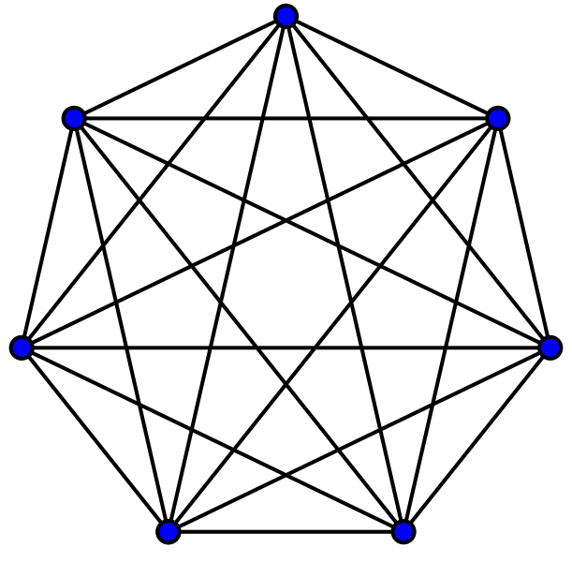
Wizard of Oz Features
Recommendations
AI Insights Page

Slide 31


Hard-Coded Features
View OH on Calendar in Student View
View Recent Journal Entries Teacher View

Slide 32
Issues and Questions
Our main conceptual hurdle right now is ironing out the details of our database, like session and persistent image storage.

Slide 33
Plans to Finish
Set up framework and database
Implement Create + Share Office Hours
Implement Record Meeting Notes
Revisit level 1-2 HE violations
Implement first task
Implement Connect with a Teacher
Refine AI Insights page

Slide 34
Prototype Demo
05
See Gloo in action!

Slide 35


Slide 36
Appendix
06
All the good stuff that didn’t fit in the presentation.

Slide 37
Heuristic Breakdown by Category + Severity
 | H1 | H2 | H3 | H4 | H5 | H6 | H7 | H8 | H9 | H10 | H11 | H12 | Total
Sev 0 | 0 | 1 | 2 | 3 | 2 | 1 | 1 | 0 | 0 | 0 | 0 | 2 | 12
Sev 1 | 2 | 1 | 2 | 3 | 1 | 2 | 1 | 2 | 0 | 0 | 0 | 3 | 17
Sev 2 | 5 | 1 | 4 | 1 | 2 | 1 | 1 | 1 | 2 | 1 | 3 | 0 | 22
Sev 3 | 2 | 1 | 2 | 1 | 2 | 0 | 1 | 0 | 0 | 2 | 0 | 0 | 11
Sev 4 | 0 | 0 | 0 | 0 | 1 | 1 | 0 | 0 | 1 | 0 | 0 | 0 | 3
Notes:
All 4 sev 4 tasks, 5 sev 3, 8 sev 2, 4 sev 1

Slide 38
Planned Revisions
Disable `+` once max interests entered
Sev: 2 (row: 28)
Inline error messages for data entry
Sev: 2 (row: 29)
Include prefix selection for teacher profile
Sev: 2 (row: 30)
Alternate search options for journal entries
Sev: 2 (row: 31)
Consistency in language to “Add”/”Create” OH
Sev: 2 (row: 32)
Decrease OH capacity after registration
Sev: 2 (row: 35)
*row elements sorted by severity
Notes:
Alerts exist

Slide 39
Planned Revisions
Increasing button surface area
Sev: 1 (row: 50)
Add text to OH listing confirming RSVP
Sev: 1 (row: 51)
Change “Meeting” to be more descriptive
Sev: 1 (row: 52)
Allow teachers to reset/clear-all for OH entry
Sev: 1 (row: 53)
Warn students of booking conflicts
Sev: 0 (row: 76)
*row elements sorted by severity
Notes:
Alerts exist

Slide 40
Unincorporated Revisions
Make profile without picture + interests
Sev: 2 (row: 26)
Unread journals
Sev: 2 (row: 27)
Linear journey path
Sev: 2 (row: 43)
Autofilling interests (pre-defined)
Sev: 1 (row: 48)
*row elements sorted by severity

Slide 41
Severity 0 Violations
Sort student entries by teachers (journaling should be therapy-like for students)
Add numbers to progress bar for profile creation (too busy)
Add minimum to interests (handled with error message)
Back buttons not fully functional (med-fi limitation)
Allow students to RSVP for recurring (potential capacity concerns)
List current/former students (some students may not be students of that teacher)
Use “notes” instead of “journal” (want recording interactions to feel less academic)
Style suggestions
* Most sev-0 not incorporated

